Slide 1
MODULE1 ..PART2..IRS
Information retrieval system
1)Covered till data…
1.1)Analog information system ……many levels, less availability
1.2)Digital information system…..only two levels to represent information, more availability
1.3) Digital information….use is more
1.4) Storage facilities…on campus(harddisk) to storage solutions(RAID)
1.5) users requirement…data back in same…..information retrieval system

Slide 2
MODULE1 ..PART2..IRS
2) Motivation for making an information retrieval system
2.1)Analog to digital…many levels to only two levels (1 & 0)
2.2)Data to information…
a) Digital data stored….available to user in user required readable form
2.3)Data retrieval…Structured information …
a) query, Database languages, database operations..
b)All these present on the storage side
c) Query formation at user side in users language…
d) Processed at database language level in processing side

Slide 3
MODULE1 ..PART2..IRS
2) Motivation for making an information retrieval system
2.4)Structured to unstructured (only text)…information retrieval requirements
a) documents storage…..different storage types and storage levels available
b) indexed by keywords….generating pointers
c)user query for data…….query writing, query formation, query help
d) user query contents keywords…..keyword identification and selection and ranking
e)search the documents based on keywords…..search methods, optimized search process
f) documents are selected…document extraction
g) ranked …..document rearranging and arrangement modification with query refining
h)presented to user or sent to client side for local storage or visualization of documents at user side

Slide 4
MODULE1 ..PART2..IRS
2) Motivation for making an information retrieval system
2.5)Structured to unstructured information
a) (multimedia elements)… text, images, songs, sound files, videos
2.6) Multimedia systems…..
b) combination of structured and unstructured….
c) direct retrieval at user side…
d) online training module, interactive website etc.
2.7) Various multimedia operations..
a) searching, querying, indexing, storage, hyperlinking, presentation, visualization, abstraction, and virtualization….

Slide 5
MODULE1 ..PART2..IRS
3) information systems….
3.1)Information systems are
a) software plus hardware based systems
b) support data-intensive applications.
3.2)information system requirements..
a) an integrated set of components for collecting, storing, and processing data
b) for providing information, knowledge, and digital products.
4) Need for information systems….
4.1)Business firms and other organizations rely on information systems to carry out and manage their operations, interact with their customers and suppliers, and compete in the marketplace.

Slide 6
MODULE1 ..PART2..IRS
4) need for information systems…cont
4.2) Information systems are used to run inter-organizational supply chains and electronic markets. For instance, corporations use information systems to process financial accounts, to manage their human resources, and to reach their potential customers with online promotions.
4.3) Many major companies are built entirely around information systems. eg eBay, a largely auction marketplace; Amazon, an expanding electronic mall and provider of cloud computing services; Alibaba, a business-to-business e-marketplace; and Google, a search engine

Slide 7
MODULE1 ..PART2..IRS
4) need for information systems…cont
4.4) Governments deploy information systems to provide cost effective services to citizens.
4.5) Digital goods—such as electronic books are available
4.6) video products, and software—and online services, such as gaming and social networking, are delivered with information systems.
4.7) Individuals rely on information systems, generally Internet-based, for conducting much of their personal lives: for socializing, study, shopping, banking, and entertainment.

Slide 8
MODULE1 ..PART2..IRS
5) Components for information systems…..
5.1) Computer hardware
5.2) Computer software
5.3)Communication
5.4) Databases and data warehouses
5.5) Human resources
5.6) Procedures

Slide 9
MODULE1 ..PART2..IRS
5) Components for information systems…cont
5.1)Computer hardware….
a) Individual level…smart phones, laptops, machines
b) Large organization…distributed computing, parallel computing, utility computing, grid computing
c) Sensors to collect informations, servers for processing, storage solutions for storage (not devices but storage systems capable of handling all required storage-related operations)
d) Basically it is the machinery and equipment’s like input output devices, processing devices, storage devices and communication devices.

Slide 10
MODULE1 ..PART2..IRS
5)components for information systems…cont
5.2)Computer software….
a) system software …operating system…it manages hardware, program files, data and other computer resources
b) Applications software’s, for processing
c) Databases for storage
d) GUI for interfaces ( designed from user interface design angle)

Slide 11
MODULE1 ..PART2..IRS
5) components for information systems…cont
5.3)Communication…
a) Communication is to connect the end devices via networks
b) Networking( bridges, repeaters, hubs ,switches) and internetworking devices(routers, gateways)
c) Data encoders and decoder…. security view point
d) Multiplexers and demultiplexers…..optimization
e) Data converters…….format changing
f) Communication channels…wired, wireless, shared, secured etc

Slide 12
MODULE1 ..PART2..IRS
5) components for information systems….cont
5.4) Databases and data warehouses…
a) Structured and unstructured information
b) Place for data storage…place provisioning (in house and outhouse) storage place management (monitoring, reporting, implementation [provisioning or deprovisioning]))
5.5) Human resources
a) Technical personnel include development and operations managers, business analysts, systems analysts and designers, database administrators, programmers, computer security specialists, and computer operators.
b) In addition, all workers in an organization must be trained to utilize the capabilities of information systems as fully as possible.

Slide 13
MODULE1 ..PART2..IRS
5) components for information systems…cont
5.6) procedures…
a) Procedures are the policies that govern the operation of an information system
b) Procedures for using, operating, and maintaining an information system are part of its documentation. eg procedures need to be established to run a payroll program, including when to run it, who is authorized to run it, and who has access to the output.
c) In the autonomous computing initiative, data centers are increasingly run automatically, with the procedures embedded in the software that controls those centers.
d) Procedures related to various operations to be performed as searching, indexing, ranking, backup, read and write operations and so on

Slide 14
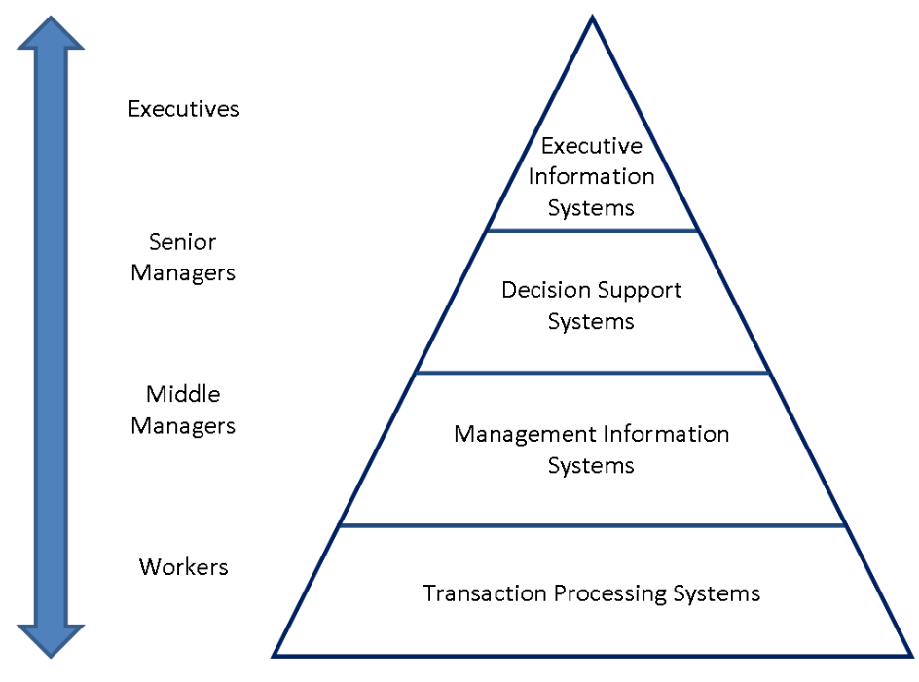
MODULE1 ..PART2..IRS
6) Types of information systems…
This reflects the hierarchy of the organizations related to information systems
6.1)Worker level: transaction processing system: number of transactions in a sequence represents the entire operation. These transactions will be performed by specialized people of that fields
6.2)Middle managers: Management information system: for coordination, control, analysis, visualization

Slide 15
MODULE1 ..PART2..IRS
6) Types of information systems…cont
6.3) Senior managers: decision support system: business or organizational level decision, operations and planning level decision of the organization
6.4)Executives: executive information systems:it gives management support by planning, and organizing to the managers at the organizational levels
7) other information systems…
7.1)systems: artificial intelligence (AI) based systems, machine learning (ML) based systems, deep learning (DL) based systems

Slide 16
MODULE1 ..PART2..IRS
7) other information systems…cont
7.2)computing platform system: an environment in which a piece of software will be executed. It will have the hardware, memory, web browser, interface, required tools
7.3) data warehouse system: data storage, retrieval., security, data analysis, data reporting…
7.4)enterprise systems: made to satisfy the need of the organization or set of organizations
7.5) enterprise resource planning system: planning and making of process

Slide 17
MODULE1 ..PART2..IRS
7) other information systems…cont
7.6) expert system: problem solving for a required task
7.7)geographical information system: database of geographical data, software tools to select and represent the required data as per the query
7.8) global information system: information collecting and decision making
7.9)management information system: decisions related to management activities as per the organization
7.10) multimedia information system: storing, editing, adding, creating, creating hyperlink and working with multimedia elements

Slide 18
MODULE1 ..PART2..IRS
7) other information systems…cont
7.11)process control system: instrumentation
7.12)social information system:….
7.13) search engine system: software designed to do web search activities
7.14) office automation system….

Slide 19
MODULE1 ..PART2..IRS
Thank You

